Slide 1

MASTR-Q: Multi-Agent Soft Time Routing using Improved Q-Learning
A research-based project focusing on advanced logistics optimization using reinforcement learning for complex vehicle routing problems.

Slide 2

Project Overview & Tech Stack
Domains
Reinforcement Learning
Operations Research
Multi-Agent Systems
Vehicle Routing Problems
Heuristic Optimization
Tech Stack
Python 3.10+
Gymnasium (for environment)
NumPy, Pandas, Matplotlib

Slide 3

Abstract: Dynamic Logistics Optimization
MASTR-Q (Multi-Agent Soft Time Routing with Q-Learning) is a reinforcement learning framework designed to solve the Multi-Vehicle Routing Problem with Soft Time Windows (MVRPSTW).
Key Features
Objective
Improved Q-learning
Plan efficient vehicle routes, minimizing total travel cost and timing violations.
Multi-agent coordination
Reward shaping
Advantage
Learns dynamic routing policies through simulation, offering scalable, real-time adaptability over traditional solvers.

Slide 4

Problem Statement: MVRPSTW
The Vehicle Routing Problem (VRP) is a core logistics challenge. The Multi-Vehicle Routing Problem with Soft Time Windows (MVRPSTW) adds temporal constraints, allowing early or late arrivals with penalties.
Traditional solvers struggle with dynamic, large-scale problems (≥100 customers). Reinforcement Learning (RL) offers adaptive policies for efficient, scalable route planning.
MASTR-Q coordinates multiple vehicles, handles flexible time windows,and adapts
dynamically to new routing instances.

Slide 5

Proposed Work: MASTR-Q Contributions
1
2
Improved Q-Learning Agent
Reward Shaping
Adaptive learning rate, epsilon-greedy + UCB exploration, replay memory for stable learning.
Unified reward function for distance, time windows, and customer satisfaction.
3
4
Curriculum Learning
Comprehensive Evaluation
Gradually increases task complexity (5 to 100 customers) for stable convergence.
Compares performance with Google OR-Tools baseline on key metrics.

Slide 6

Scope & Objectives
Scope
Objectives
Generalizable multi-agent RL for large logistics networks (20–100 nodes).
Design custom MVRPSTW simulation environment with dynamic conditions.
Flexible penalty-based soft time windows.
Develop Improved Q-Learning agent with adaptive exploration and efficient state representations.
Transferable policies without retraining.
Evaluate using Solomon’s benchmark VRPTW datasets and compare with traditional approaches.
Produce interactive visualizations and document hyperparameter tuning.

Slide 7
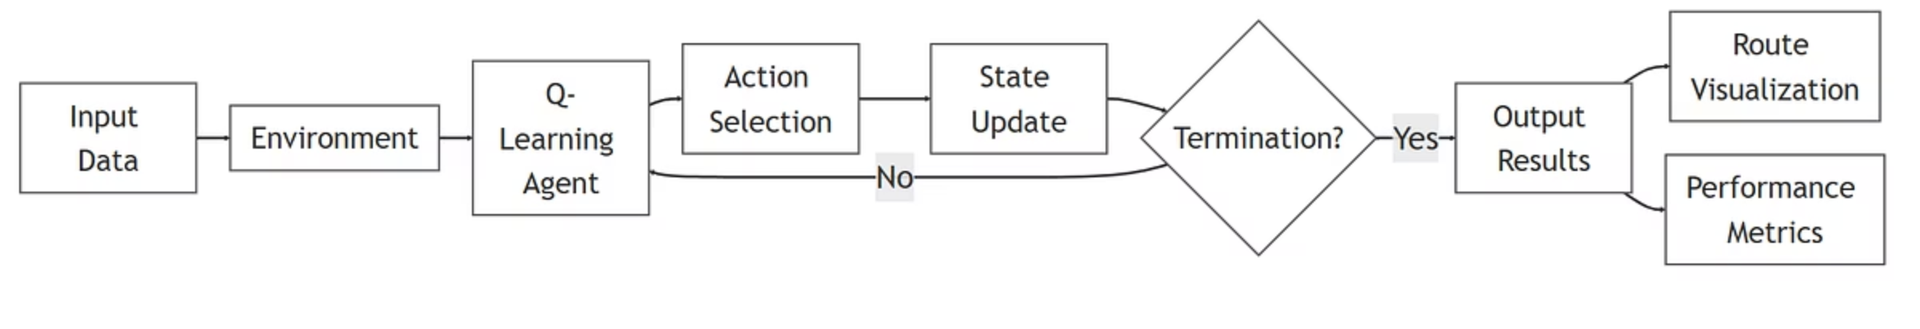

MASTR-Q Framework: High-Level Workflow
The MASTR-Q framework provides an end-to-end solution for multi-agent soft time routing.
This diagram illustrates the overall process, from data input to optimized route generation.

Slide 8
Algorithm: Improved Q-Learning
The core of MASTR-Q is an Improved Q-Learning algorithm designed for MVRPSTW.
1
2
3
Initialization
Hyperparameters
Episode Loop
Q(s,a) = 0 for all state-action pairs.
Learning rate (α), discount factor (γ), exploration rate (ϵ) with decay.
Reset environment, choose actions, observe rewards, update Q-values.
4
5
Exploration Decay
Best Policy
ϵ decreases over time to balance exploration and exploitation.
Save Q-table with highest episode reward.

Slide 9
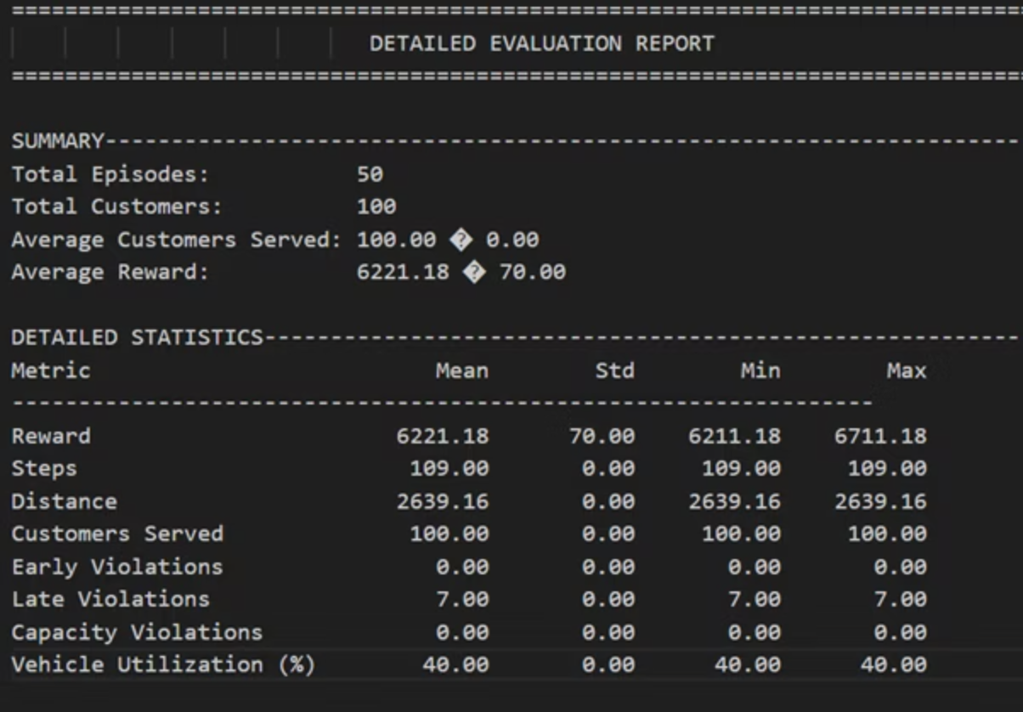
Experimental Study: Performance & Compliance
Key Performance Indicators
Customer Service Rate: 100%
Average Reward: 6,221.18
Total Distance: 2,639.16
Vehicle Utilization: 40%
Constraint Compliance
Early Arrivals: 0.00
Late Arrivals: 7.00
Capacity Violations: 0.00
MASTR-Q achieved perfect service reliability and maintained strict operational constraint compliance.

Slide 10

Conclusion & Future Work
Conclusion
Future Work
MASTR-Q demonstrates the feasibility of RL for multi-vehicle route optimization under soft time constraints, achieving:
Replace tabular Q-Learning with Deep Q-Networks (DQN).
Integrate Transformer encoders for state representations.
Faster convergence
Extend to online dynamic routing for real-time fleet dispatch.
Lower route costs
Implement federated learning for distributed fleets.
High vehicle utilization
Visualize interactive routes via a web-based dashboard.
Minimal time violations
Scalable performance

